Slide 1
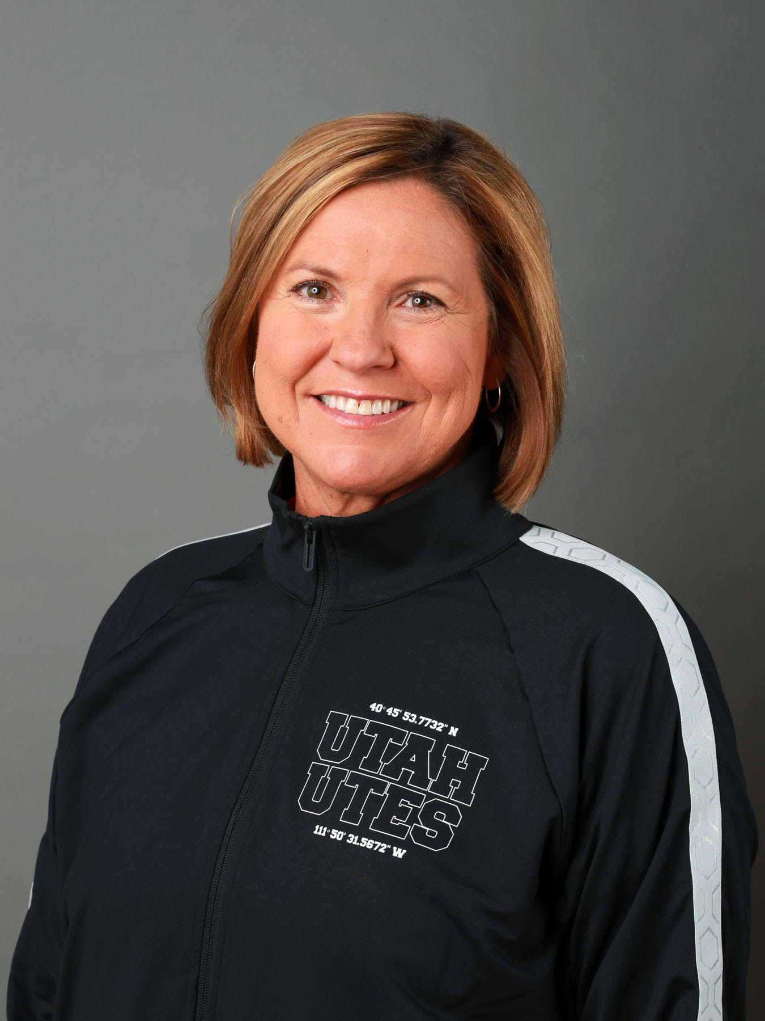


Slide 2
The leadership agenda:
Type here
Type here
Above the Line
Type here
Type here
Below the Line
Notes:
Above the line / below the line.
This is the WHAT to delegate
Day-t0-day operations on how to do it in the Pac-12
Simple tool that shows how to delegate. Above the line, you have to do it yourself. Below the line. Others could do it and you need to delegate
Mired in management trying to do everything yourself

Slide 3
Radar Screen - Outside moving in:
Issue | Good for us or bad for us?

Slide 4
Radar Screen - Inside moving out:
Issue | Good for us or bad for us?

Slide 5
What parts of your program would you plot where?
Better positioned for the world of three years ago
Well positioned for the world of three years from now

Slide 6
All-American
The Utah RED Chart:
14
All-Conference
5
Solid Starter
3
1
Marginal Starter
2
Solid Bench
End of Bench
Fast Rising
Still Growing
At Ceiling

